Slide 1





SPRING & SPRING BOOT
LECTURE - 2

Slide 2

Today’s Agenda
Advantages Of Spring
History of Spring Framework
Spring Release Timeline
Introduction To Spring Modules

Slide 3
Advantages Of Spring Framework
Loose Coupling
Simplified Development
Easy Integration
Secure
Stable and lots of resources

Slide 4
History of Spring Framework
Spring is a versatile framework which can be used to develop any type of application.
It was written by Rod Johnson and was released in June 2003 under Apache license.

Slide 5
History of Spring Framework
However its first Production version i.e. 1.0 version was released in March 2004 .
As of now it is under the license of VMWare and its latest Version is 6.1.9.

Slide 6
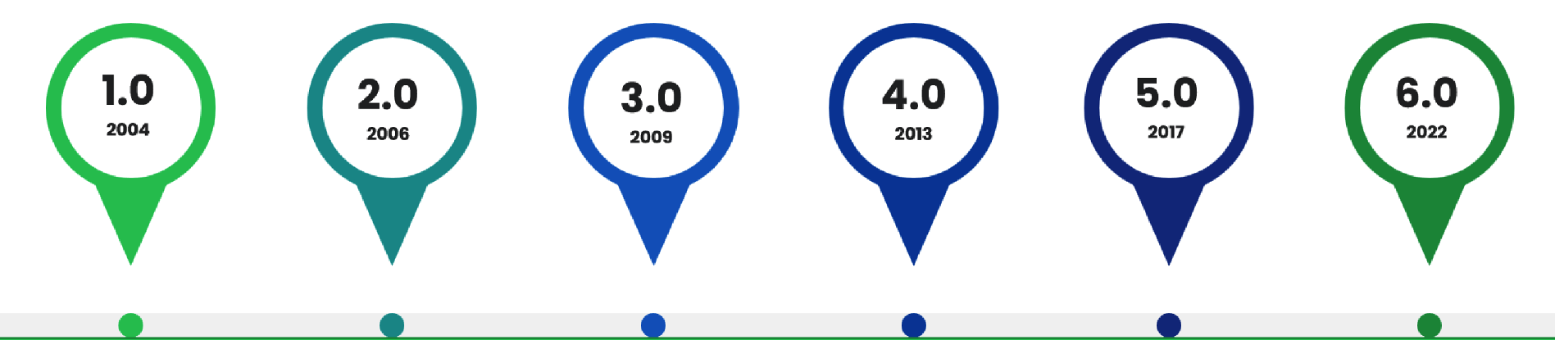
Spring Release Timeline
SPRING VERSION HISTORY

Slide 7
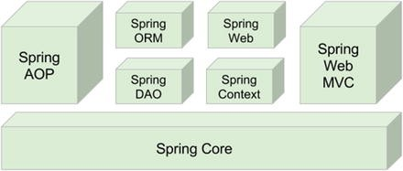
Spring 1.x version

Slide 8
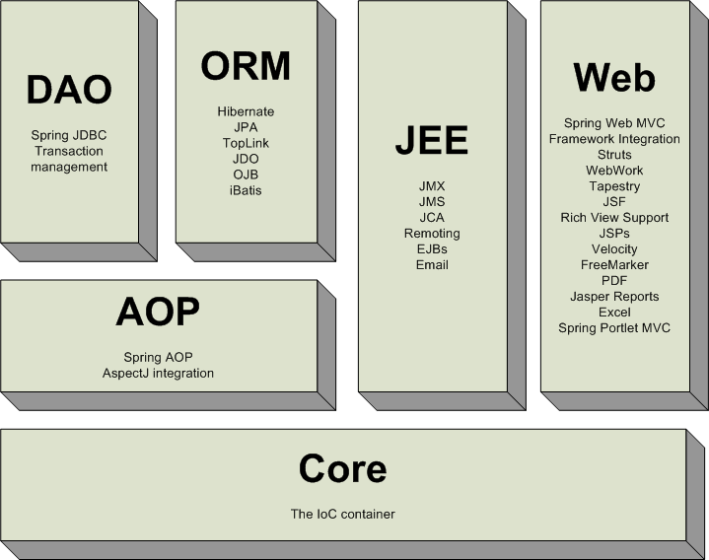
Spring 2.x version

Slide 9
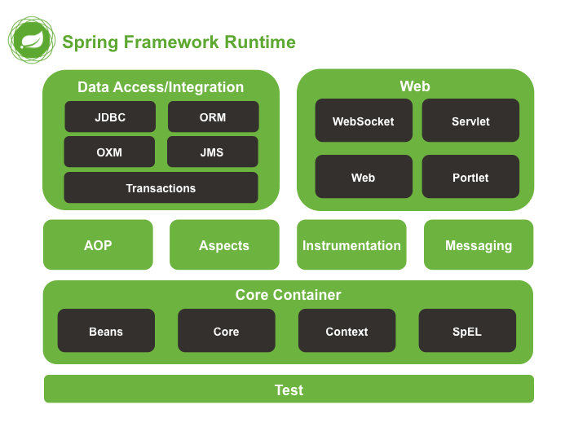
Spring 6.x version

Slide 10
Spring Modules
1.
Spring Core
4.
Spring ORM
2.
Spring Context
5.
Spring Data JPA
3.
Spring JDBC
6.
Spring Web MVC

Slide 11
Spring Modules
7.
Spring REST
10.
Spring AOP
8.
Spring Batch
11.
Spring Security
9.
Spring Boot
12.
Spring Cloud

Slide 12
Spring Core
Spring Core is the base module in the Spring Framework.
It provides fundamental concepts of Spring Framework.
And the two most important concepts given by Spring Core are :
IOC
DI

Slide 13
Spring Context
Spring Context helps us to set up configurations.
Configuration means informing the Spring Framework that which classes we want the Spring/IOC container to manage for us.

Slide 14
Spring JDBC
Spring JDBC is used to simplify our database communication logic.
In pure JDBC we need to write boiler plate code (repeated code) like below in several classes.
Load Driver
Get Connection
Create Statement
Execute Query
Process Result
Close Connection

Slide 15
Spring JDBC
However using Spring JDBC we only have to perform step 4 & 5 and the remaining steps are taken care of automatically.

Slide 16
Spring ORM
Spring ORM is used to integrate ORM framework like Hibernate within the Spring Environment.
The benefit of ORM is that it allows us to represent tables as java classes and the table data as java objects rather than rows.

Slide 17
Spring Data JPA
Spring Data JPA is an extension to ORM.
It makes our DB interaction super easy.
This is because it provides us readymade methods to perform CRUD operations .

Slide 18
Spring WEB MVC
Spring Web MVC is used to develop both Web Applications as well as Distributed applications.
Web Applications: Those apps which are accessed by users using their browsers like gmail,facebook,Instagram etc.
Distributed Applications: Those apps that run on multiple computers simultaneously and are designed to be accessed by users from different devices and locations. For ex: Banking Applications

Slide 19
Spring REST
Spring REST, focuses on building RESTful web services.
REST stands for Representational State Transfer, and it is an architectural style for designing distributed applications.

Slide 20
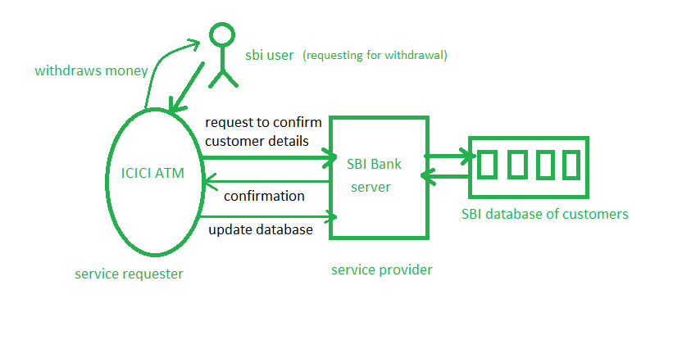
Spring REST

Slide 21
Spring Batch
The term Batch means Bulk Operations.
For example:
Reading and storing multiple records in the database.
Monthly account statements sent by a bank to its customers
Sending SMS to students about new course launch.
To handle all such operations the Spring framework provides us a module called Spring Batch.

Slide 22
Spring Boot
Spring Boot is an extension of Spring Framework.
It provides the ability to create Spring applications that can run immediately without writing lots of additional code.
The biggest advantage of using Spring Boot versus Spring Framework is the ease of use and faster development.

Slide 23
Spring AOP
AOP stands for Aspect Oriented Programming.
Just like POP and OOP it is also a methodology or approach.

Slide 24
Spring AOP
It allows us to separate the cross cutting logics in an application.
The word cross cutting logics means secondary logics in an application like security , transaction mgmt, logging, exception handling, etc

Slide 25
Spring Security
Security is the most crucial part of any application.
And the Spring Security module helps us to achieve security in our Spring application.
Using Spring Security we can implement both Authentication and Authorization in our programs.
It also provides us single sign on feature as well as protection against attacks like csrf, session fixation etc.

Slide 26
Spring Cloud
Spring Cloud provides us configurations for Microservices.
Microservice is an architecture that allows us to break down a single large application into smaller and independently deployable services.

Slide 27
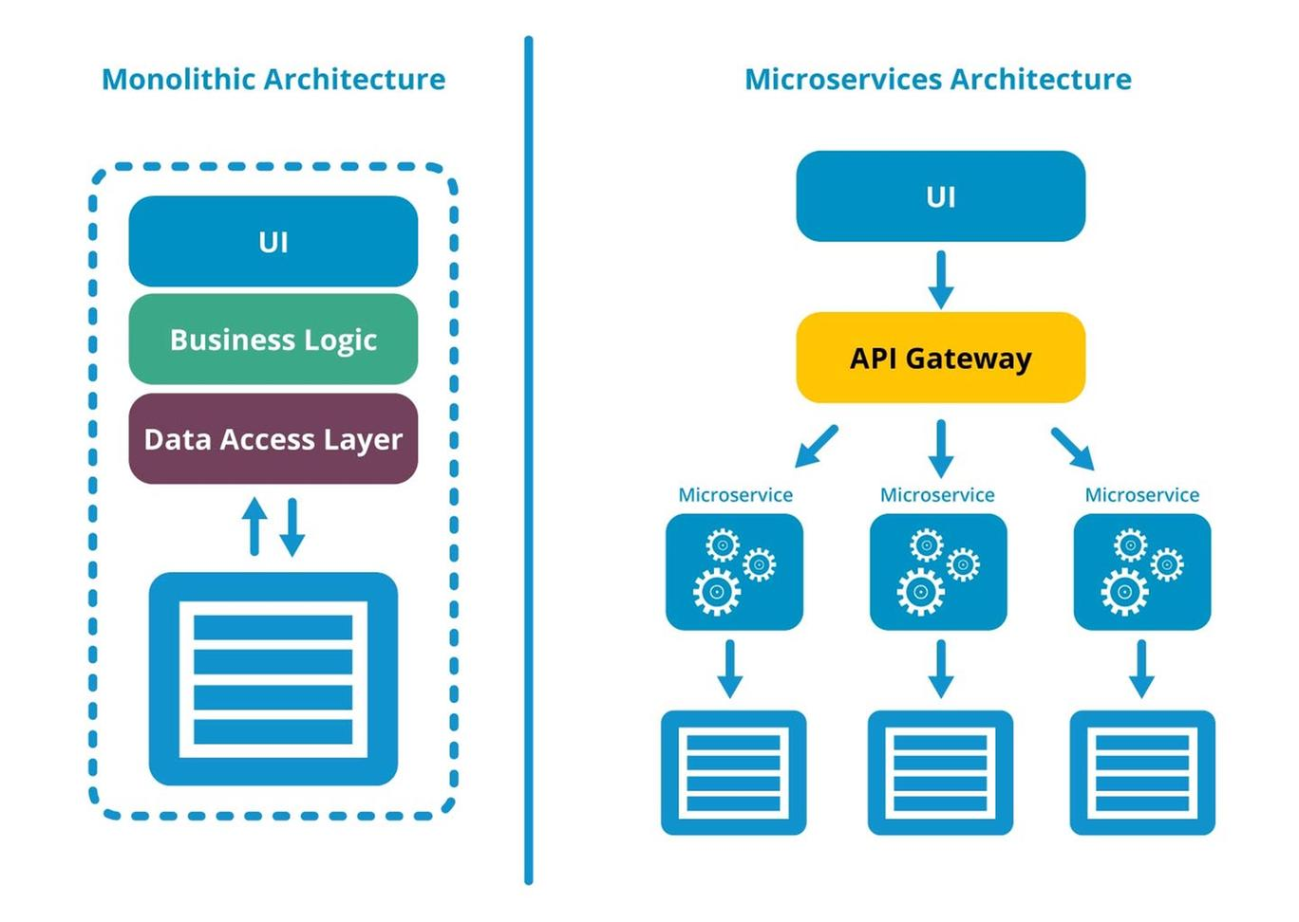
Microservices Architecture

Slide 28
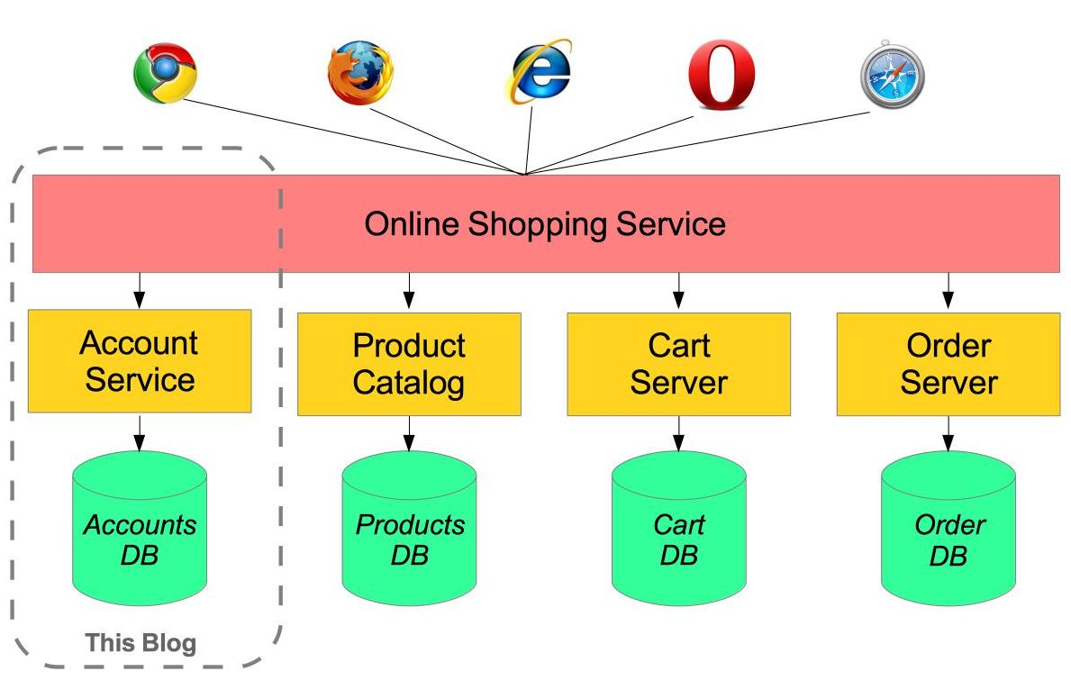
Microservices Architecture

